Slide 1
2022 Year 7 Science Classifications Living vs Non-Living Things

Slide 2
Brainstorm:
How do know if something is living?

Slide 3
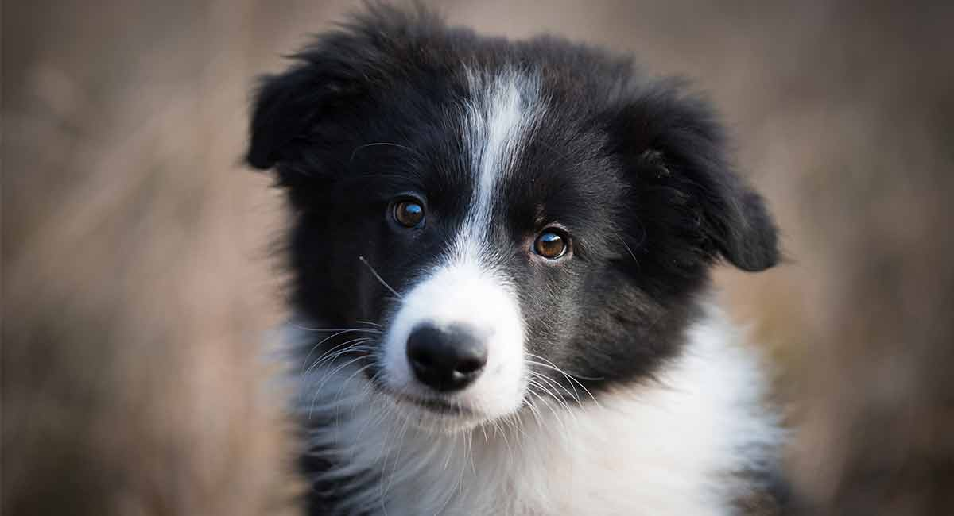
Living or Non-Living? Puppy

Slide 4

Living or Non-Living? Rubber Ducky

Slide 5
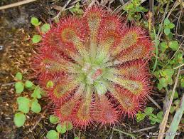
Living or Non-Living? Plant

Slide 6
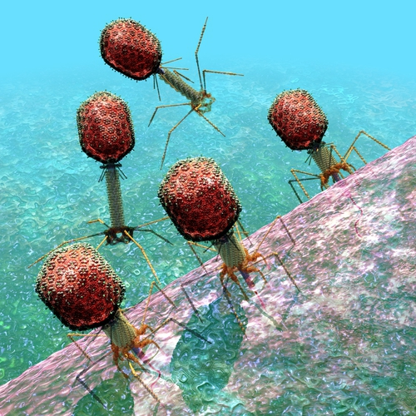
Living or Non-Living? Virus

Slide 7

Living or Non-Living? Robots

Slide 8

Living or Non-Living? Fire

Slide 9

Living or Non-Living?
You may see that some people in the class disagree with what you think
Scientist overcome this problem by setting up a certain criteria that an object must posses to be a living thing

Slide 10
Living Things Criteria
There are 8 criteria that distinguish if something is living or non-living, these include:
M – Movement
R – Reproduce
N – Nutrient
G – Grow
R - Respond
E – Exchange Gases
W – Waste
W- Water
“MR N GREWW”

Slide 11
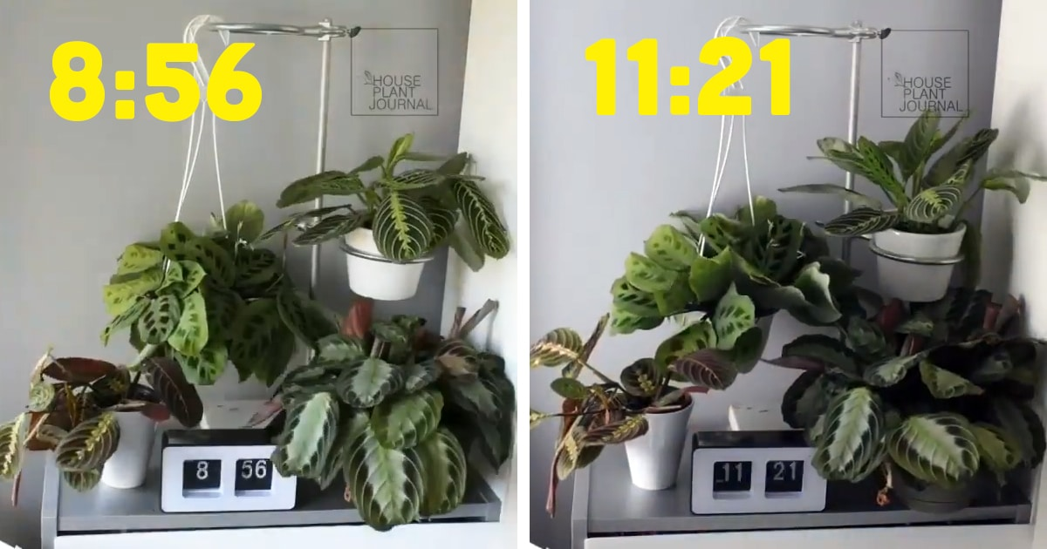
“MR N GREWW” M is for Movement
If the object can move by itself it satisfies the first criteria!
Plants and animals can move by themselves

Slide 12
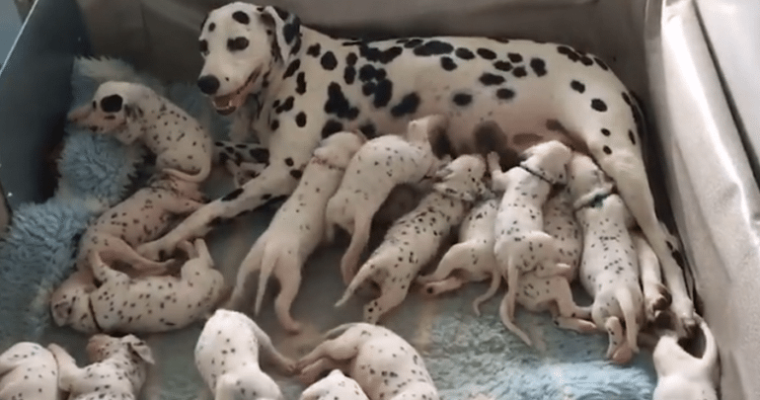
“MR N GREWW” R is for Reproduce
Living things make new individuals that grow up to look like them.
Reproduction is the process by which living things produce offspring's.
Animals mate and produce offsprings
Plants produce seeds
Bacteria dividing itself

Slide 13
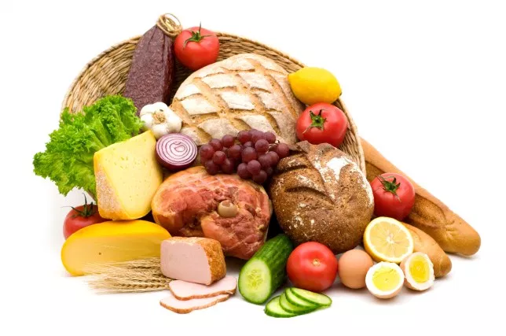
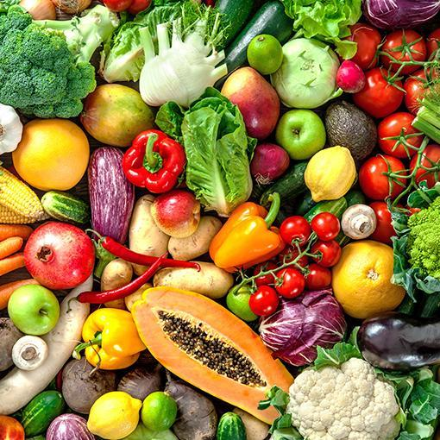
“MR N GREWW” N is for nutrients
All living things need Nutrients to survive.
Animals obtain nutrients by eating food and drinking
Plants absorb nutrients through their roots
Fungi feed on decaying organisms

Slide 14

“MR N GREWW” G is for GROW
All living things grow. Get bigger! Develop!
Humans are born as babies and develop to adults
Insects hatch from eggs as larva, then metamorphose into an adult

Slide 15
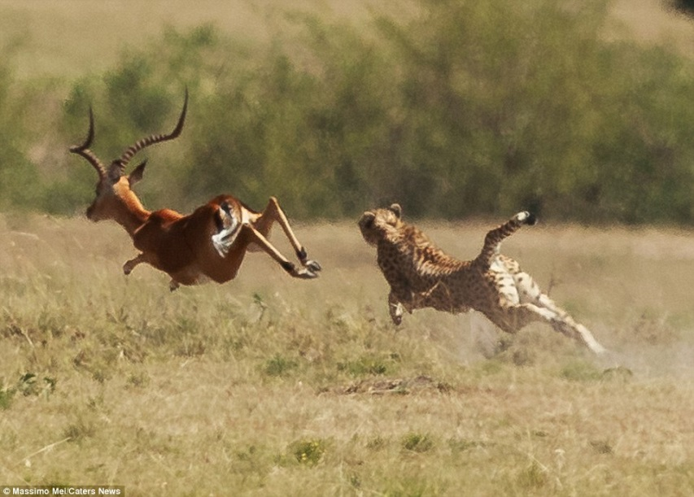
“MR N GREWW” R is for Respond
All living things respond to stimuli or changes to an environment.
When you touch something hot you react
When a predator chases an antelope, it runs
When it is dark, the plant moves towards the sun

Slide 16
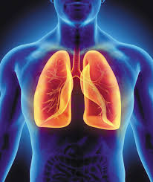
“MR N GREWW” E is for Exchange Gases
All living things can exchange gases within them.
When animals breathe, they take in oxygen and produce carbon dioxide
Plants take in carbon dioxide and produce oxygen. But at night time plants also take in oxygen to produce carbon dioxide
Water animals have gills to breathe through water

Slide 17
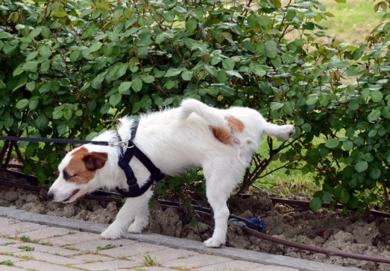
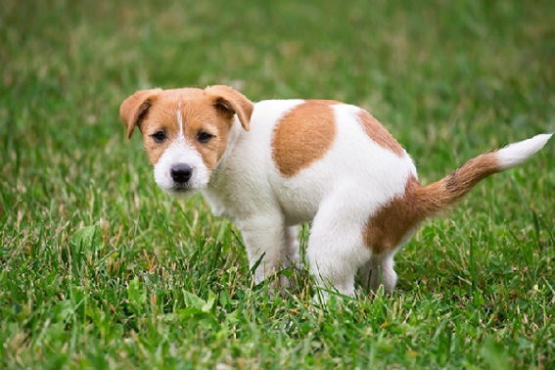
“MR N GREWW” W is for Wastes
All living things produce and get rid of wastes.
Animals take in food, water and air to fuel their bodies. Waste get produced. By exhaling, urinating or defecating our bodies get rid of wastes.
Plants get rid of their wastes through their leaves

Slide 18

“MR N GREWW” W is for Water
All living things need water.
It is required for many jobs
Helps transport substances in our bodies
Important for chemical reactions within the body
Maintain temperature

Slide 19

Lets try this again Living or Non-Living? Doggo
M- Move?
R – Reproduce?
N –Nutrients? G – Grow?
R – Respond? E – Exchange Gas? W – Waste? W- Water?
So is it Living?

Slide 20
Lets try this again Living or Non-Living? Doggo
M- Move? YES
R – Reproduce? YES
N –Nutrients? YES G – Grow? YES
R – Respond? YES E – Exchange Gas? YES W – Waste? YES W- Water? YES
So is it Living? YES!

Slide 21
Lets try this again Living or Non-Living? Rubber Ducky
M- Move?
R – Reproduce?
N –Nutrients? G – Grow?
R – Respond? E – Exchange Gas? W – Waste? W- Water?
So is it Living?

Slide 22
Lets try this again Living or Non-Living? Rubber Ducky
M- Move? NO
R – Reproduce? NO
N –Nutrients? NO G – Grow? NO
R – Respond? NO E – Exchange Gas? NO W – Waste? NO W- Water? NO
So is it Living? NO

Slide 23
Lets try this again Living or Non-Living? Plant
M- Move?
R – Reproduce?
N –Nutrients? G – Grow?
R – Respond? E – Exchange Gas? W – Waste? W- Water?
So is it Living?

Slide 24
Lets try this again Living or Non-Living? Plant
M- Move? YES
R – Reproduce? YES
N –Nutrients? YES G – Grow? YES
R – Respond? YES E – Exchange Gas? YES W – Waste? YES W- Water? YES
So is it Living? YES!

Slide 25
Lets try this again Living or Non-Living? Virus
M- Move?
R – Reproduce?
N –Nutrients? G – Grow?
R – Respond? E – Exchange Gas? W – Waste? W- Water?
So is it Living?

Slide 26
Lets try this again Living or Non-Living? Virus
M- Move? YES
R – Reproduce? YES
N –Nutrients? NO G – Grow? NO
R – Respond? NO E – Exchange Gas? NO W – Waste? NO W- Water? YES
So is it Living? NO!

Slide 27
Lets try this again Living or Non-Living? Robots
M- Move?
R – Reproduce?
N –Nutrients? G – Grow?
R – Respond? E – Exchange Gas? W – Waste? W- Water?
So is it Living?

Slide 28
Lets try this again Living or Non-Living? Robots
M- Move? YES
R – Reproduce? NO
N –Nutrients? NO G – Grow? NO
R – Respond? YES E – Exchange Gas? NO W – Waste? NO W- Water? NO
So is it Living? NO!

Slide 29
Lets try this again Living or Non-Living? Fire
M- Move?
R – Reproduce?
N –Nutrients? G – Grow?
R – Respond? E – Exchange Gas? W – Waste? W- Water?
So is it Living?

Slide 30
Lets try this again Living or Non-Living? Fire
M- Move? YES
R – Reproduce? YES
N –Nutrients? YES G – Grow? YES
R – Respond? YES E – Exchange Gas? YES W – Waste? YES W- Water? NO
So is it Living? NO!

Slide 31

Student Task
Complete the worksheet using your notes as a reference to help you answer the questions.

